Slide 1
Core Java – Class 7

Slide 2
Topics
Exception Handling
try, catch, throw, throws, finally
Checked and RuntimeExceptions
Arrays
Collections
Lists
Maps

Slide 3
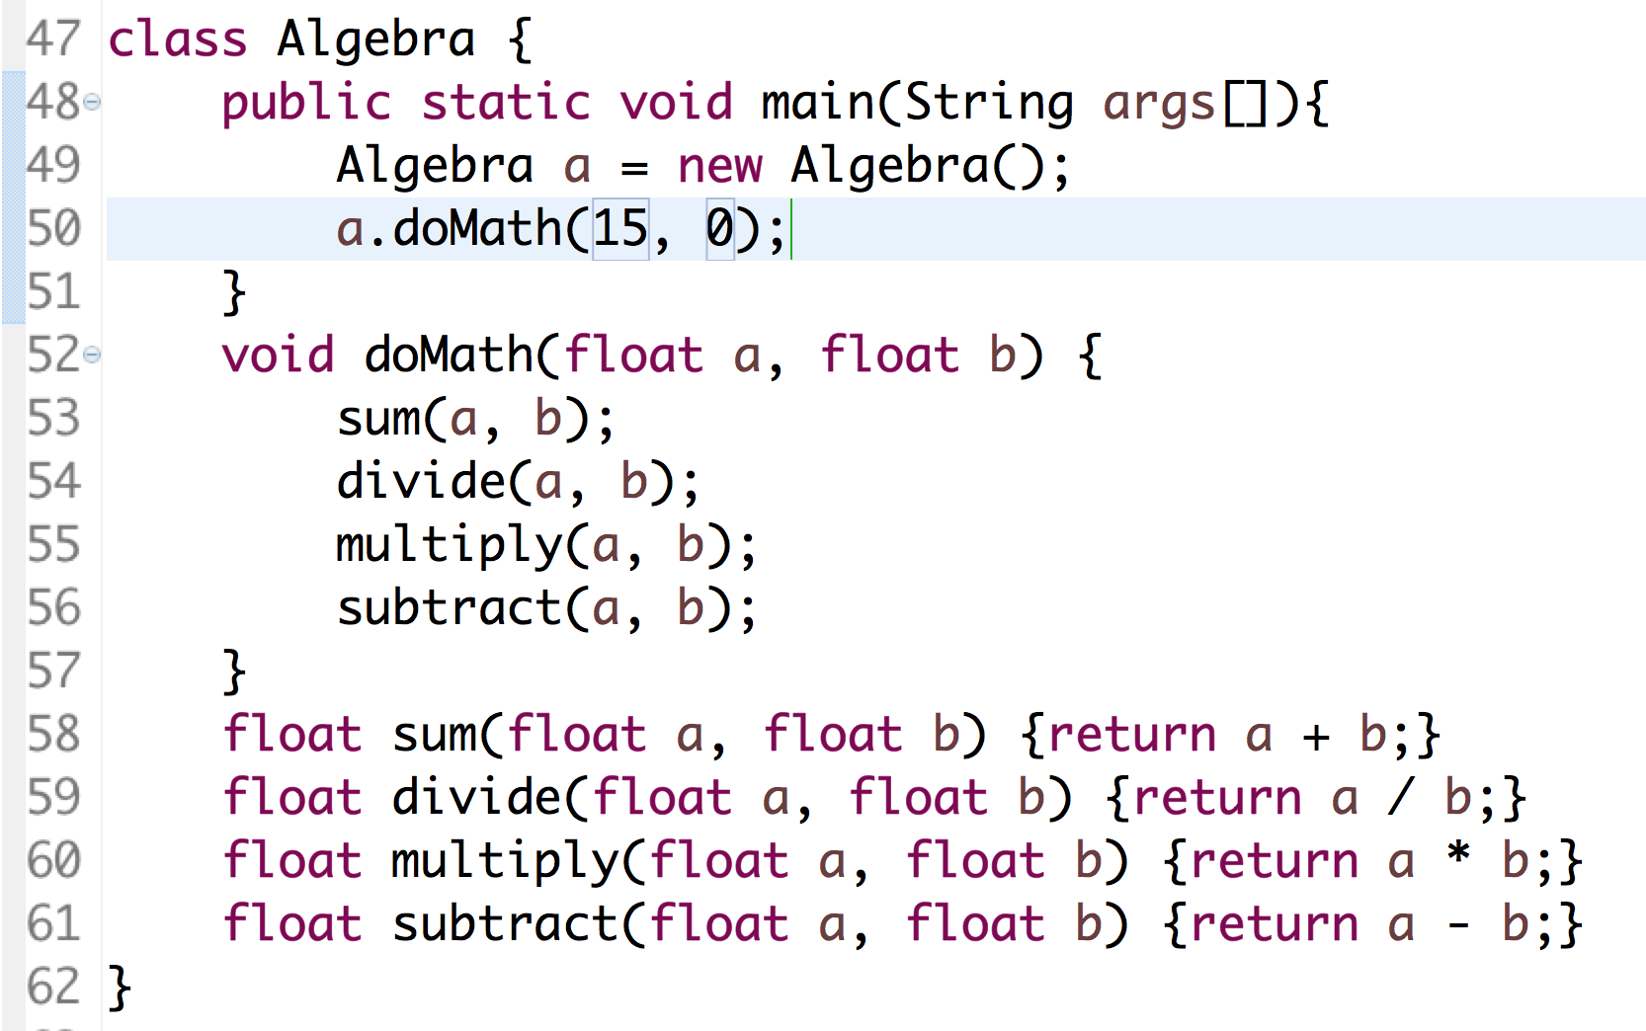
Exception Handling
Exception is a situation when something unexpected happens while executing code
Java provides mechanisms to handle exceptions

Slide 4
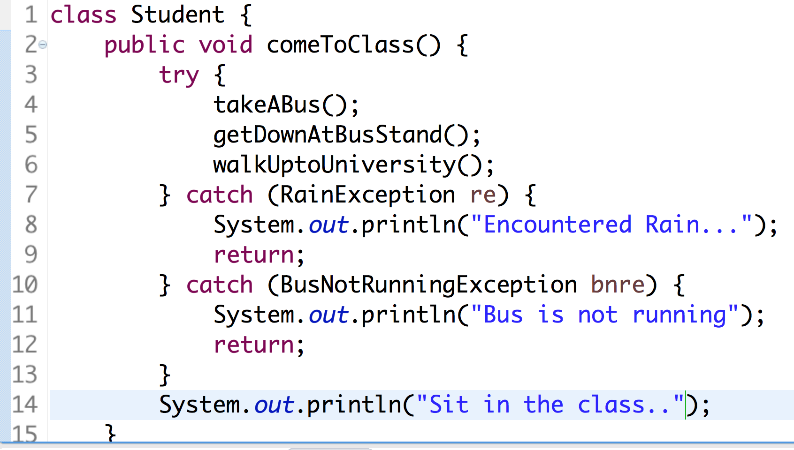
try, catch, throw, throws
Piece of code where you except a problem can happen should be surrounded with try and catch blocks

